Slide 1
Statistical Analysis of Time series
Basic statistical characteristics of time series.
Autocorrelation function.
Analysis on Stationarity.
Specificity of time series analysis as statistical task.

Slide 2
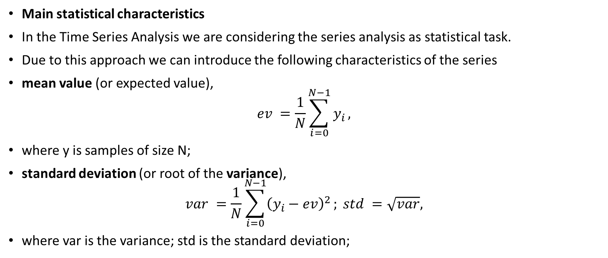
The statistical characteristics of the time series
Main statistical characteristics
In the Time Series Analysis we are considering the series analysis as statistical task.
Due to this approach we can introduce the following characteristics of the series
mean value (or expected value),
$$ev =\frac{1}{N}\sum_{i=0}^{N−1}{y_{i}},$$
where y is samples of size N;
standard deviation (or root of the variance),
$$var =\frac{1}{N}\sum_{i=0}^{N−1}{{\left(y_{i}−ev\right)}^{2}}; std =\sqrt{var},$$
where var is the variance; std is the standard deviation;

Slide 3
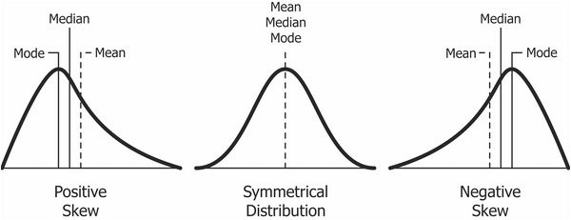
The statistical characteristics of the time series
Pleas note
beside the mean value we can introduce
Median: Median is the middle score for a set of data that has been arranged in order of magnitude. For example, given an ordered list of student marks, [14 35 45 55 55 56 58 65 87 89 92], median is 56 because it is the middle mark since there are 5 items before it, 5 items after it.
Mode: Mode is the most frequent score in our data set.

Slide 4
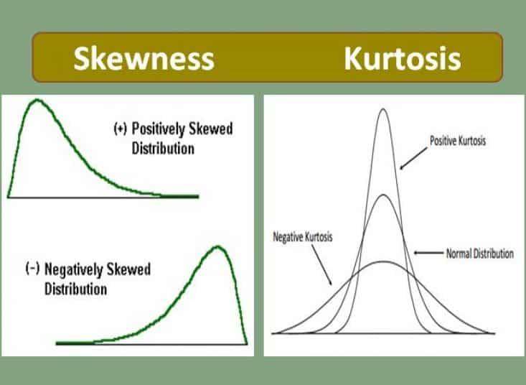
The statistical characteristics of the time series
Pleas note
beside the variance we can introduce:
Meand Absolute Deviation -Difference between mean and other values.
Skewness is a measure of symmetry, or more precisely, the lack of symmetry. A distribution, or data set, is symmetric if it looks the same to the left and right of the central point.
Kurtosis is a measure of whether the data are heavy-tailed or light-tailed relative to a normal distribution. That is, data sets with high kurtosis tend to have heavy tails, or outliers. Data sets with low kurtosis tend to have light tails, or lack of outliers.

Slide 5
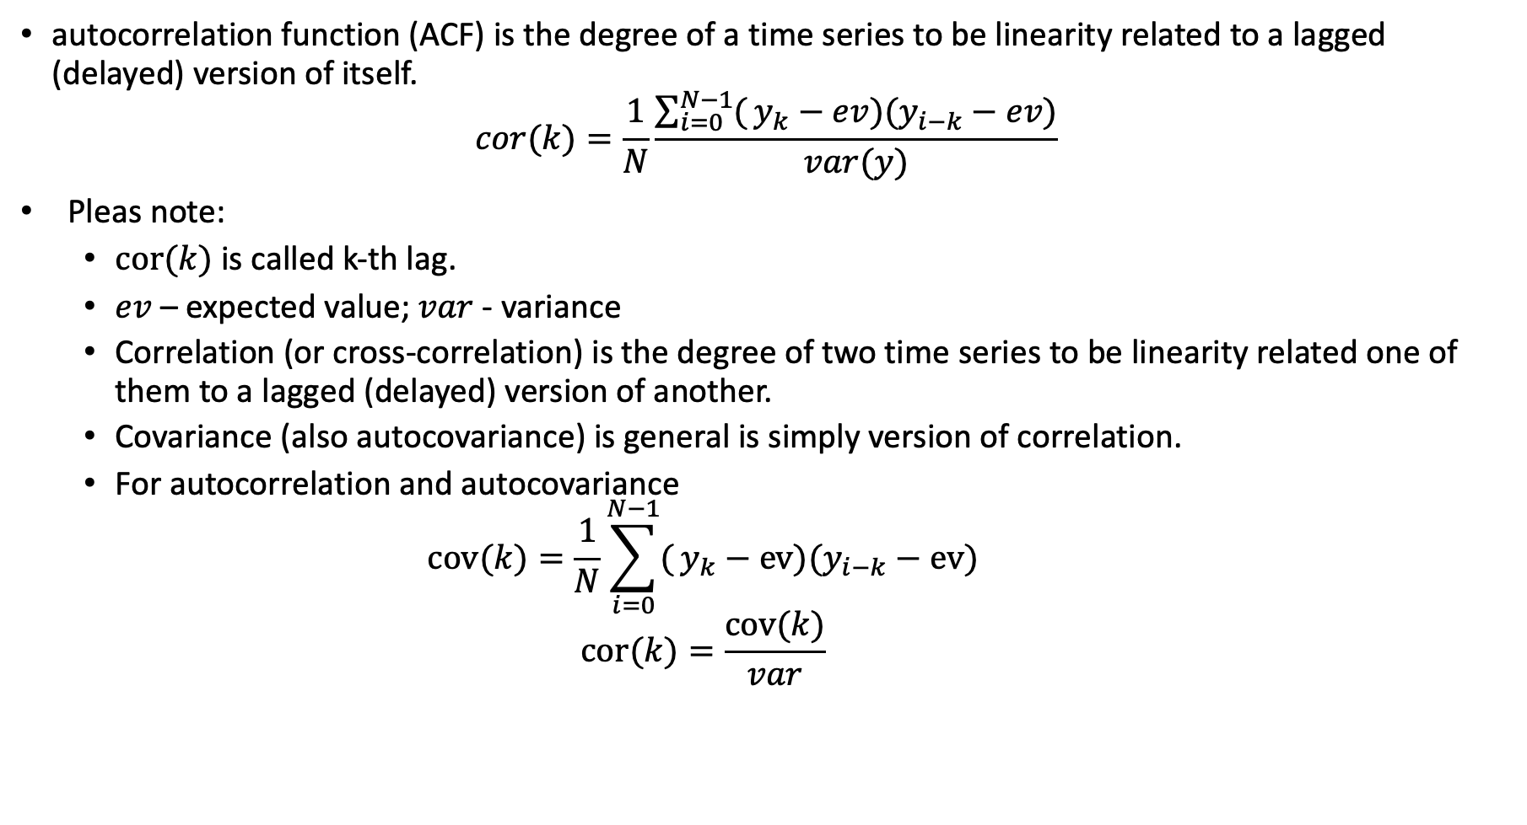
Autocorrelation function
autocorrelation function (ACF) is the degree of a time series to be linearity related to a lagged (delayed) version of itself.
$$cor(k)=\frac{1}{N}\frac{\sum_{i=0}^{N−1}{(}y_{k}−ev)(y_{i−k}−ev)}{var(y)}$$
Pleas note:
$cor(k)$ is called k-th lag.
$ev$ – expected value; $var$ - variance
Correlation (or cross-correlation) is the degree of two time series to be linearity related one of them to a lagged (delayed) version of another.
Covariance (also autocovariance) is general is simply version of correlation.
For autocorrelation and autocovariance
$$cov(k)=\frac{1}{N}\sum_{i=0}^{N−1}{(}y_{k}−ev)(y_{i−k}−ev)$$
$$cor(k)=\frac{cov(k)}{var}$$

Slide 6
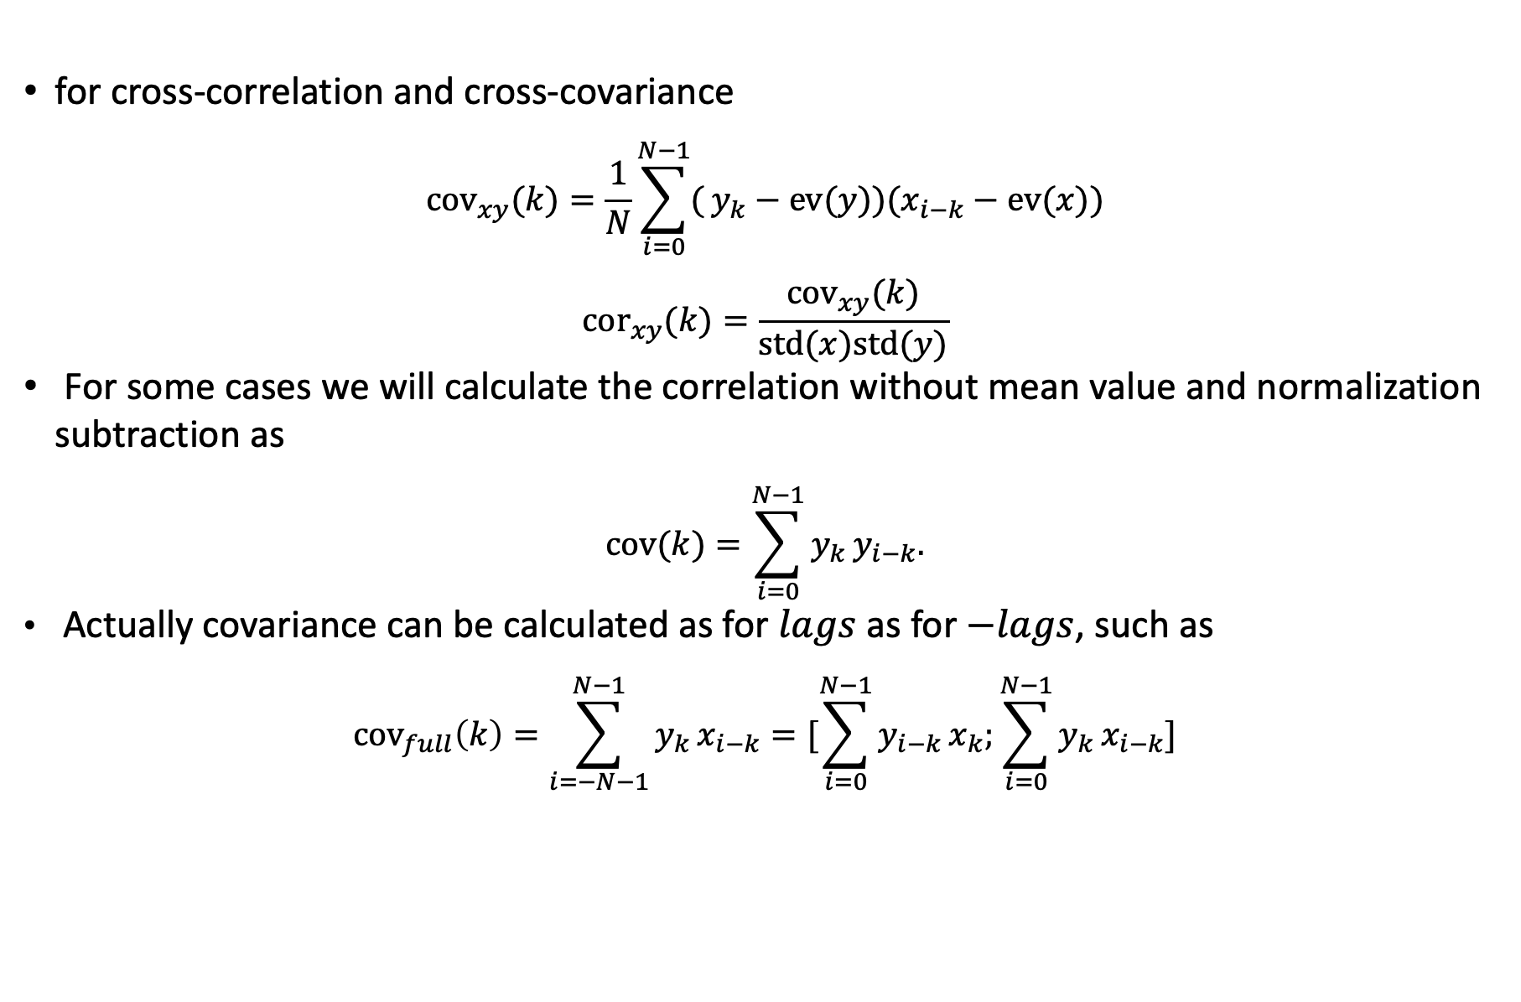
Other correlation functions
for cross-correlation and cross-covariance
$${cov}_{xy}(k)=\frac{1}{N}\sum_{i=0}^{N−1}{(}y_{k}−ev(y))(x_{i−k}−ev(x))$$
$${cor}_{xy}(k)=\frac{{cov}_{xy}(k)}{std(x)std(y)}$$
For some cases we will calculate the correlation without mean value and normalization subtraction as
$$cov(k)=\sum_{i=0}^{N−1}{y_{k}}y_{i−k}.$$
Actually covariance can be calculated as for $lags$ as for $−lags$, such as
$${cov}_{full}\left(k\right)=\sum_{i=−N−1}^{N−1}{y_{k}}x_{i−k}=[\sum_{i=0}^{N−1}{y_{i−k}}x_{k};\sum_{i=0}^{N−1}{y_{k}}x_{i−k}]$$

Slide 7
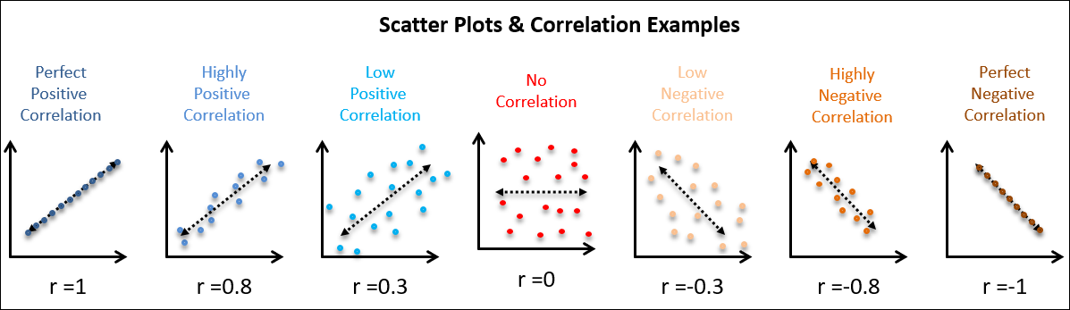
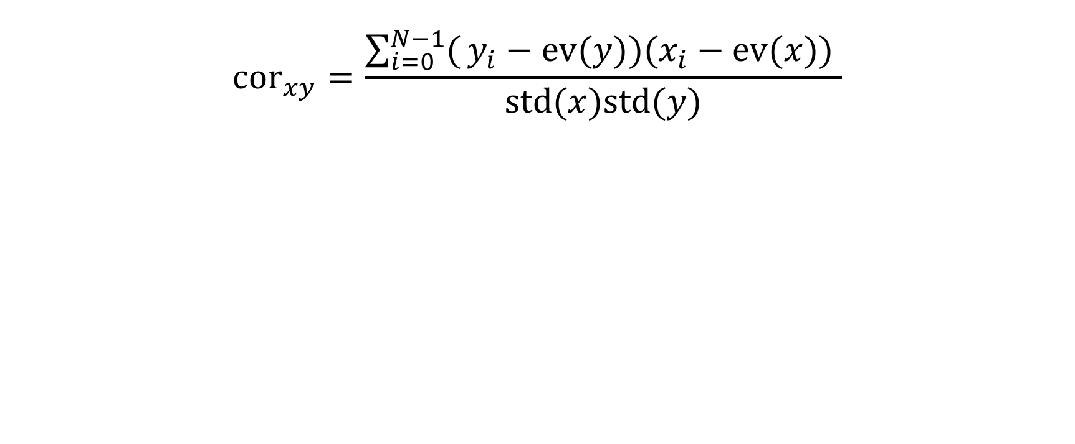
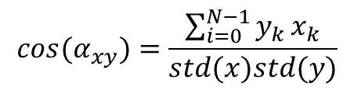
Correlation coefficient
$${cor}_{xy}=\frac{\sum_{i=0}^{N−1}{(}y_{i}−ev(y))(x_{i}−ev(x)) }{std(x)std(y)}$$
$$cos(α_{xy})=\frac{\sum_{i=0}^{N−1}{y_{k}}x_{k}}{std(x)std(y)}$$

Slide 8
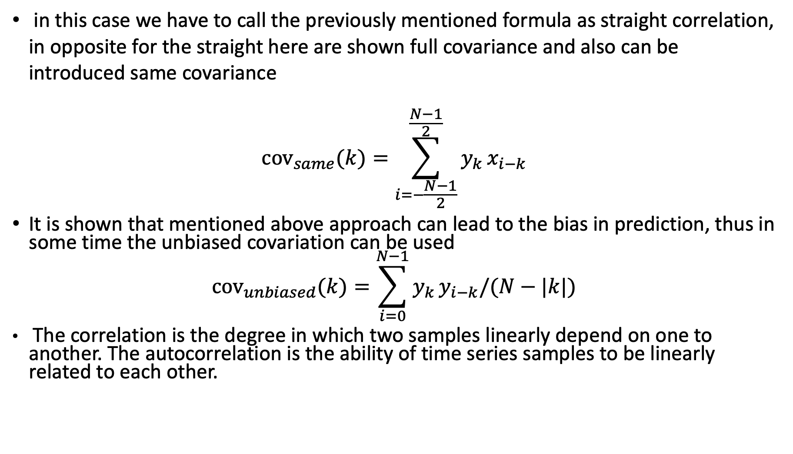
Other cross-correlation functions
in this case we have to call the previously mentioned formula as straight correlation, in opposite for the straight here are shown full covariance and also can be introduced same covariance
$${cov}_{same}(k)=\sum_{i=−\frac{N−1}{2}}^{\frac{N−1}{2}}{y_{k}}x_{i−k}$$
It is shown that mentioned above approach can lead to the bias in prediction, thus in some time the unbiased covariation can be used
$${cov}_{unbiased}(k)=\sum_{i=0}^{N−1}{y_{k}}y_{i−k}/(N−|k|)$$
The correlation is the degree in which two samples linearly depend on one to another. The autocorrelation is the ability of time series samples to be linearly related to each other.

Slide 9
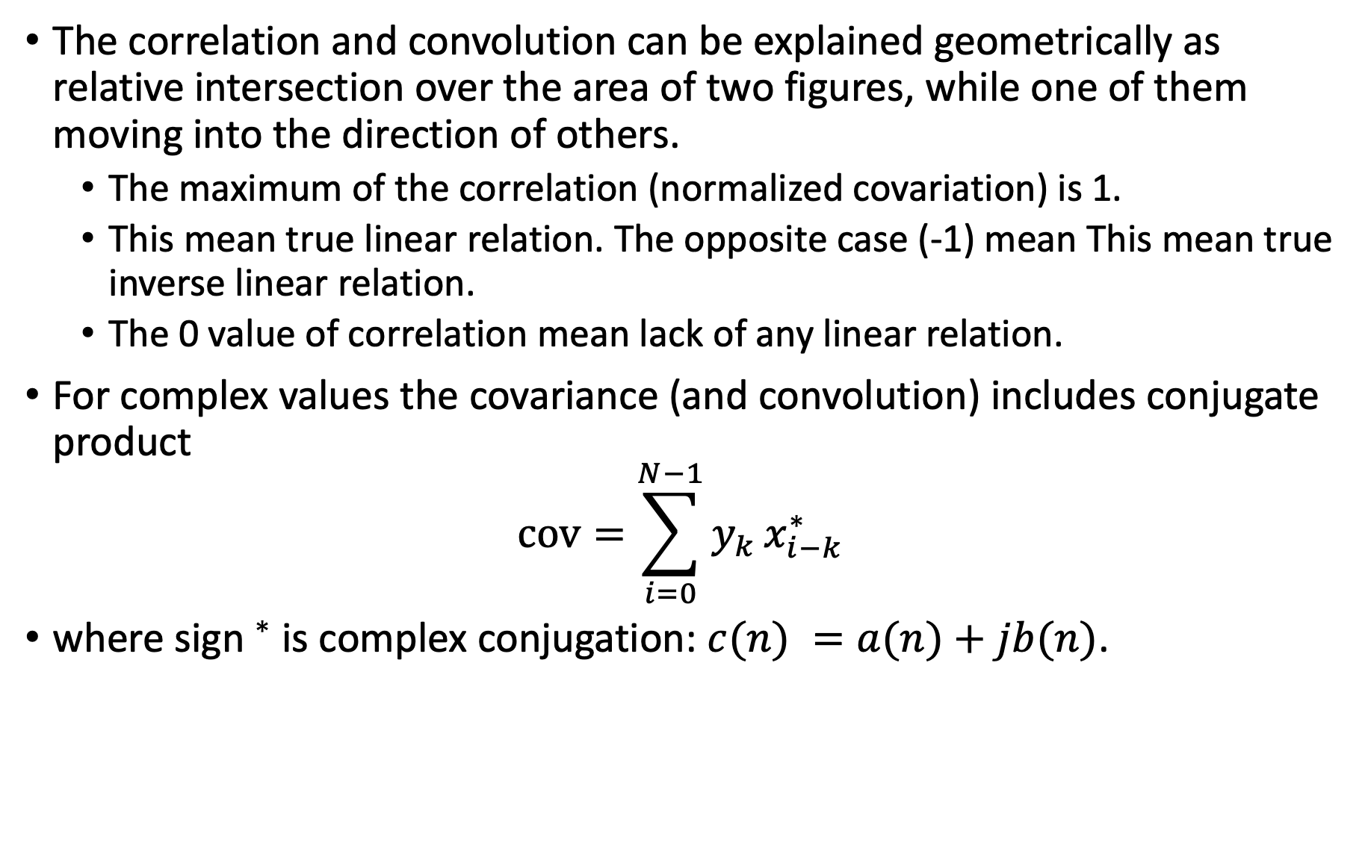
cross-correlation function
The correlation and convolution can be explained geometrically as relative intersection over the area of two figures, while one of them moving into the direction of others.
The maximum of the correlation (normalized covariation) is 1.
This mean true linear relation. The opposite case (-1) mean This mean true inverse linear relation.
The 0 value of correlation mean lack of any linear relation.
For complex values the covariance (and convolution) includes conjugate product
$$cov=\sum_{i=0}^{N−1}{y_{k}}x_{i−k}^{∗}$$
where sign $​^{∗}$ is complex conjugation: $c(n) =a(n)+jb(n)$.

Slide 10
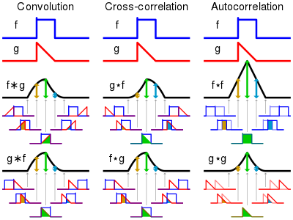
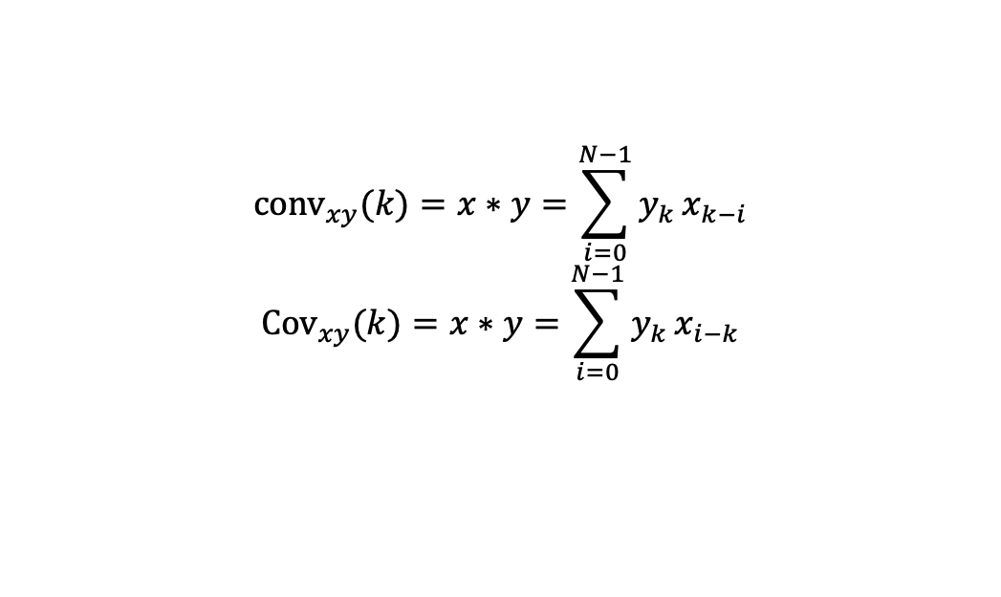
Convolution and correlation function
Among all cases of covariance behaviors the specific case can be defined, when the covariance value depends only on the difference between lags indexes and nothing more- this case we may call ergodic process.
This case corresponds to the constant mean and variance values for each partial sample sizes.
The operation or our simplified covariance corresponds to the convolution that are taken for reversed lagged version of samples
$${conv}_{xy}(k)=x∗y=\sum_{i=0}^{N−1}{y_{k}}x_{k−i}$$
$${Cov}_{xy}(k)=x∗y=\sum_{i=0}^{N−1}{y_{k}}x_{i−k}$$

Slide 11
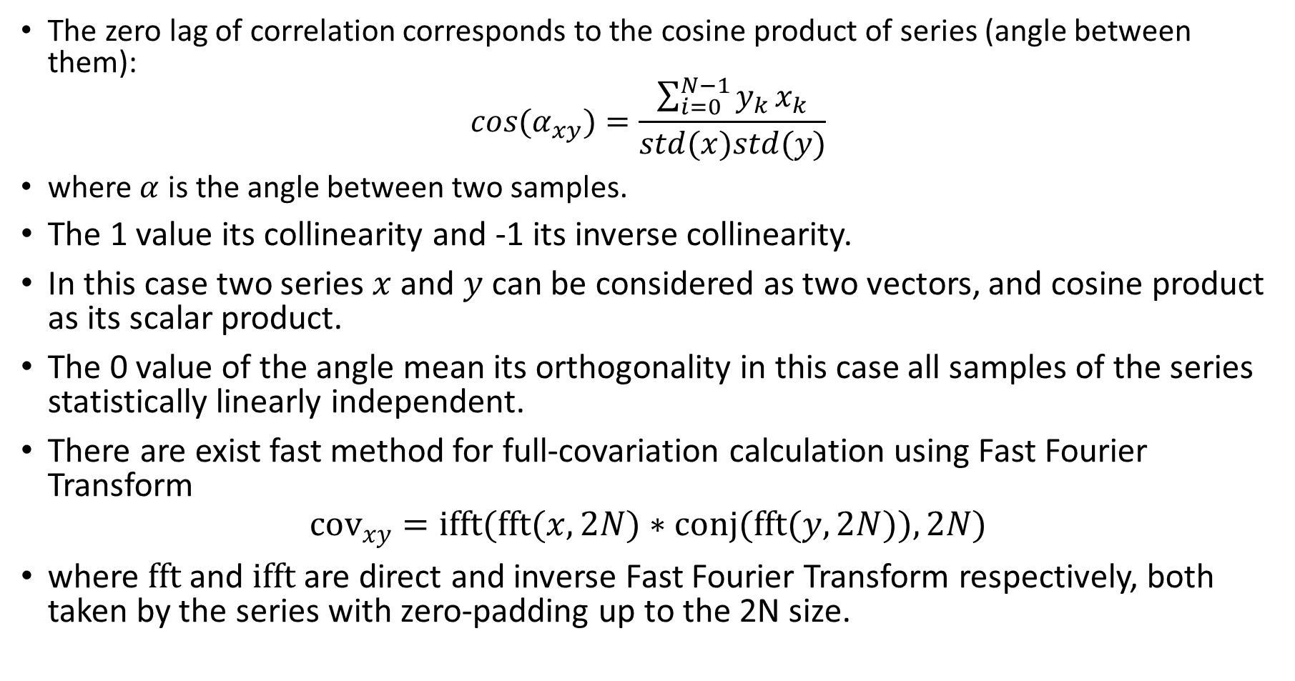
cross-correlation function
The zero lag of correlation corresponds to the cosine product of series (angle between them):
$$cos(α_{xy})=\frac{\sum_{i=0}^{N−1}{y_{k}}x_{k}}{std(x)std(y)}$$
where $α$ is the angle between two samples.
The 1 value its collinearity and -1 its inverse collinearity.
In this case two series $x$ and $y$ can be considered as two vectors, and cosine product as its scalar product.
The 0 value of the angle mean its orthogonality in this case all samples of the series statistically linearly independent.
There are exist fast method for full-covariation calculation using Fast Fourier Transform
$${cov}_{xy}=ifft(fft(x,2N)∗conj(fft(y,2N)),2N)$$
where $fft$ and $ifft$ are direct and inverse Fast Fourier Transform respectively, both taken by the series with zero-padding up to the 2N size.

Slide 12
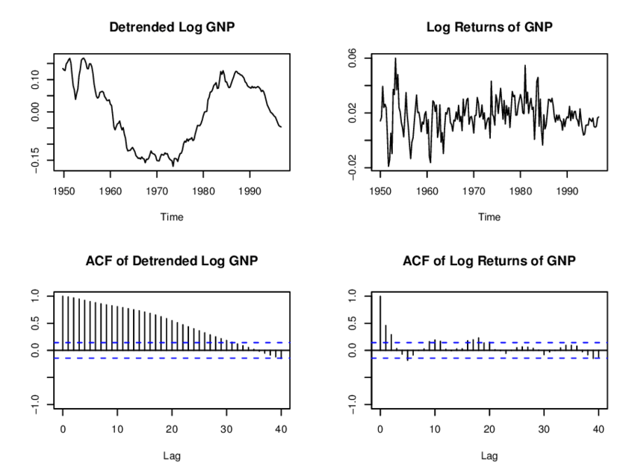
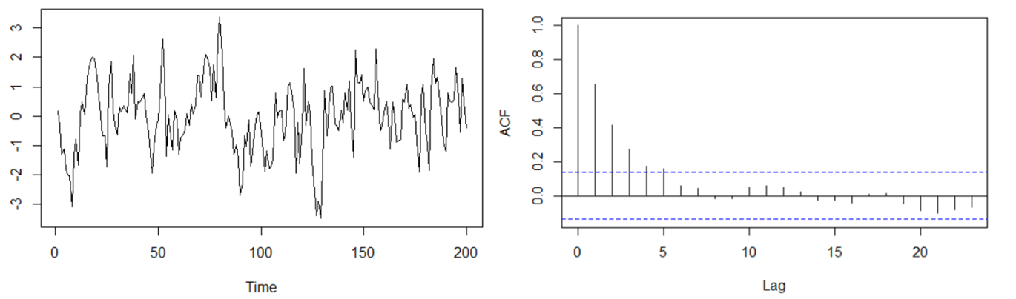
cross-correlation function
Example of ACF. Blue line show the confidence (equal to the variance).

Slide 13
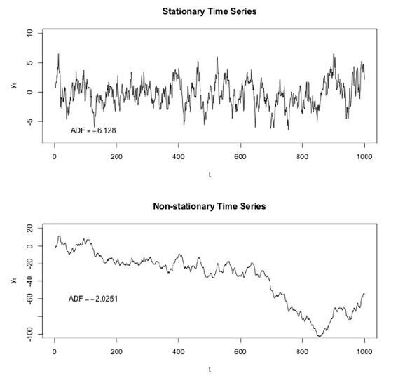
Analysis of stationarity
The analysis of mean value and std value behavior of the time series allows to distinguish the following cases:
Stationary series - a time series is said to be stationary if its statistical properties do not change over time. In other words, it has constant mean and variance, and covariance depends only on lags index difference. More precisely it have to be added that mentioned statistical characteristics have to be non-infinity values.
The previous definition can be called weak-stationary. In opposite the strong-stationary mean that the series (and its distribution in statistical point of view) do not change over a time.
Non-Stationary series - a time series is said to be non-stationary if some of its statistical properties have changes over time. In other words, it has variable of time mean, variance, or other statistical characteristics.

Slide 14
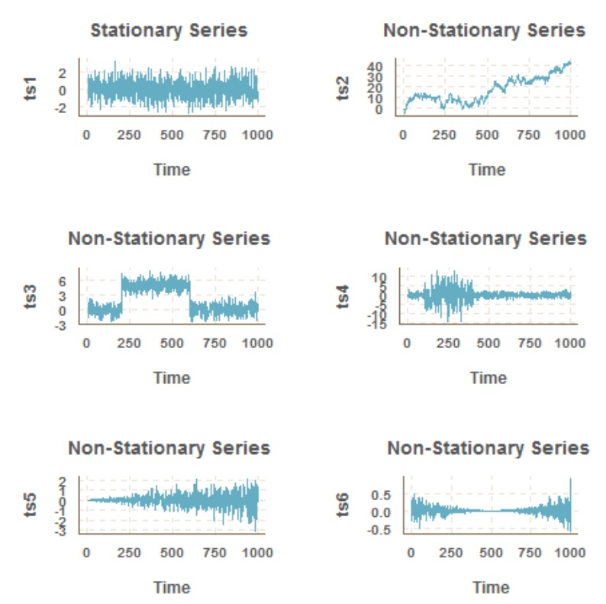
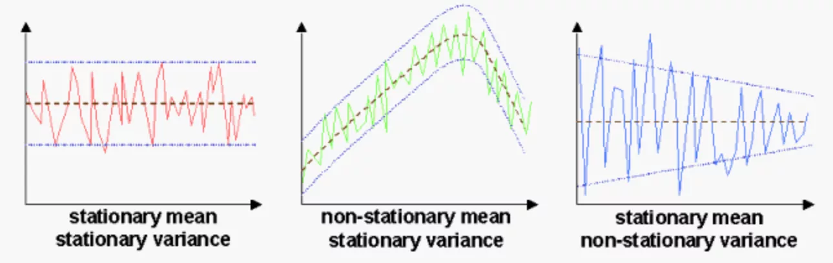
Examples of Stationarity

Slide 15
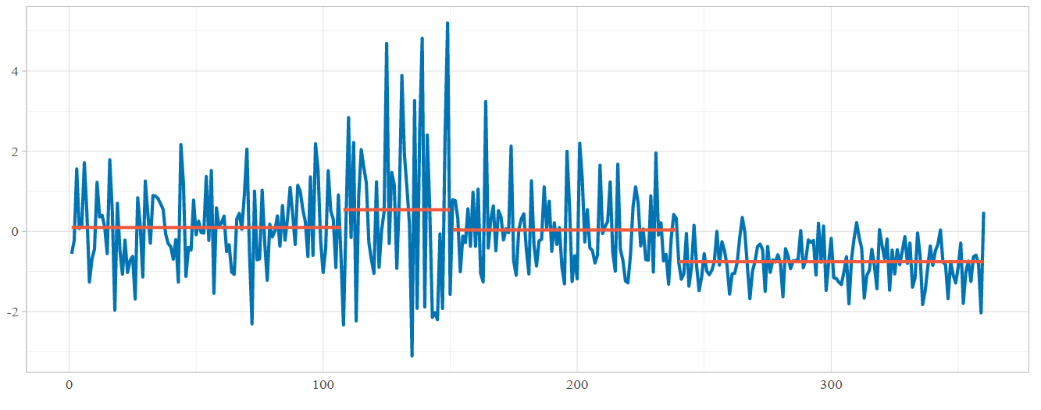
Analysis of stationarity
It is important to note
Ideally, we want to have a stationary time series for modeling. Due to the not all of series stationary, we can make different transformations to make them stationary.
The stationary time series can be described by only its mean and variance (and covariance) values, for non-stationary time series there are exist a lot of other statistical characteristics.
We can consider stationary behavior for each part of time series: trend, cyclicity, seasonality, noises.
Example of non-stationary series with different mean and variance values

Slide 16
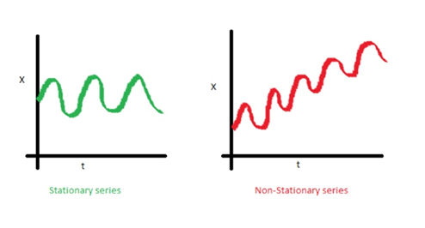
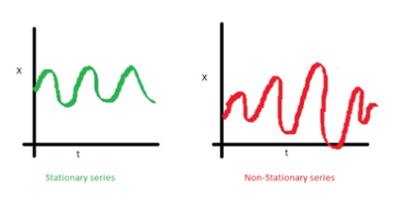
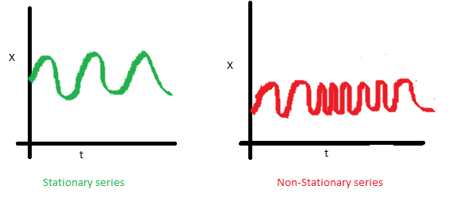
Analysis of stationarity
Example of trend line stationarity
Example of seasonal stationarity (in meaning of the variance)
Example of seasonal stationarity (in meaning of the period of seasonality)

Slide 17
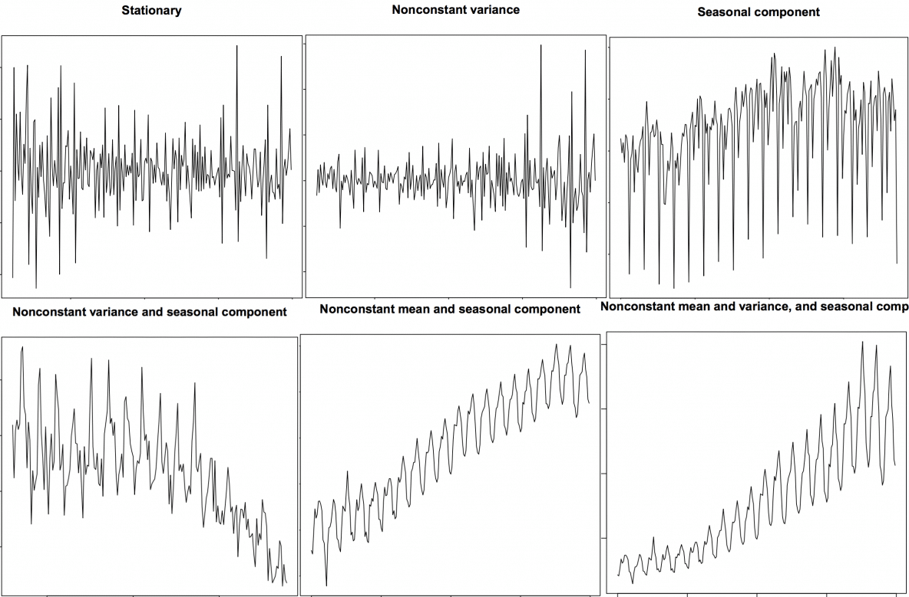
Analysis of non-stationarity
Examples of non-stationarity

Slide 18
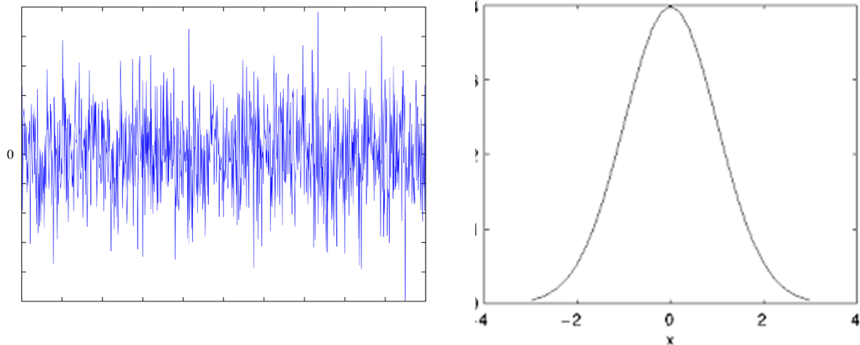
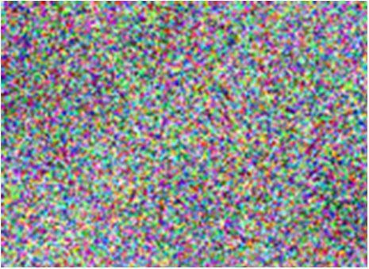
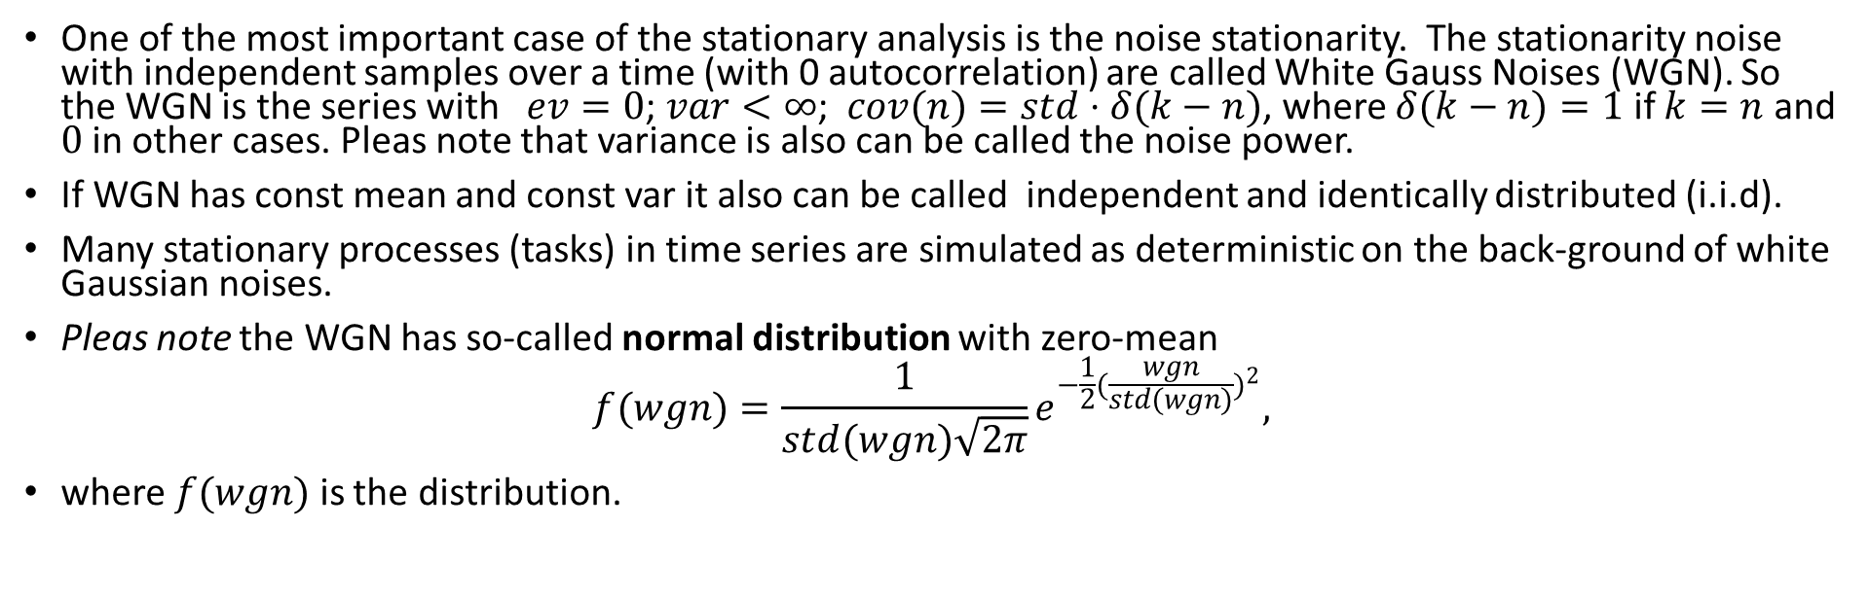
White Gaussian Noises
One of the most important case of the stationary analysis is the noise stationarity. The stationarity noise with independent samples over a time (with 0 autocorrelation) are called White Gauss Noises (WGN). So the WGN is the series with $ev=0$; $var<∞$; $cov(n)=std⋅δ(k−n)$, where $δ(k−n)=1$ if $k=n$ and $0$ in other cases. Pleas note that variance is also can be called the noise power.
If WGN has const mean and const var it also can be called independent and identically distributed (i.i.d).
Many stationary processes (tasks) in time series are simulated as deterministic on the back-ground of white Gaussian noises.
Pleas note the WGN has so-called normal distribution with zero-mean
$$f(wgn)=\frac{1}{std(wgn)\sqrt{2π}}e^{−\frac{1}{2}(\frac{wgn}{std(wgn)})^{2}},$$
where $f(wgn)$ is the distribution.
Example of wgn –
is when you turn out antenna
from tv and see so-called "snow"
i.i.d. –
Identically
independent
distribution

Slide 19
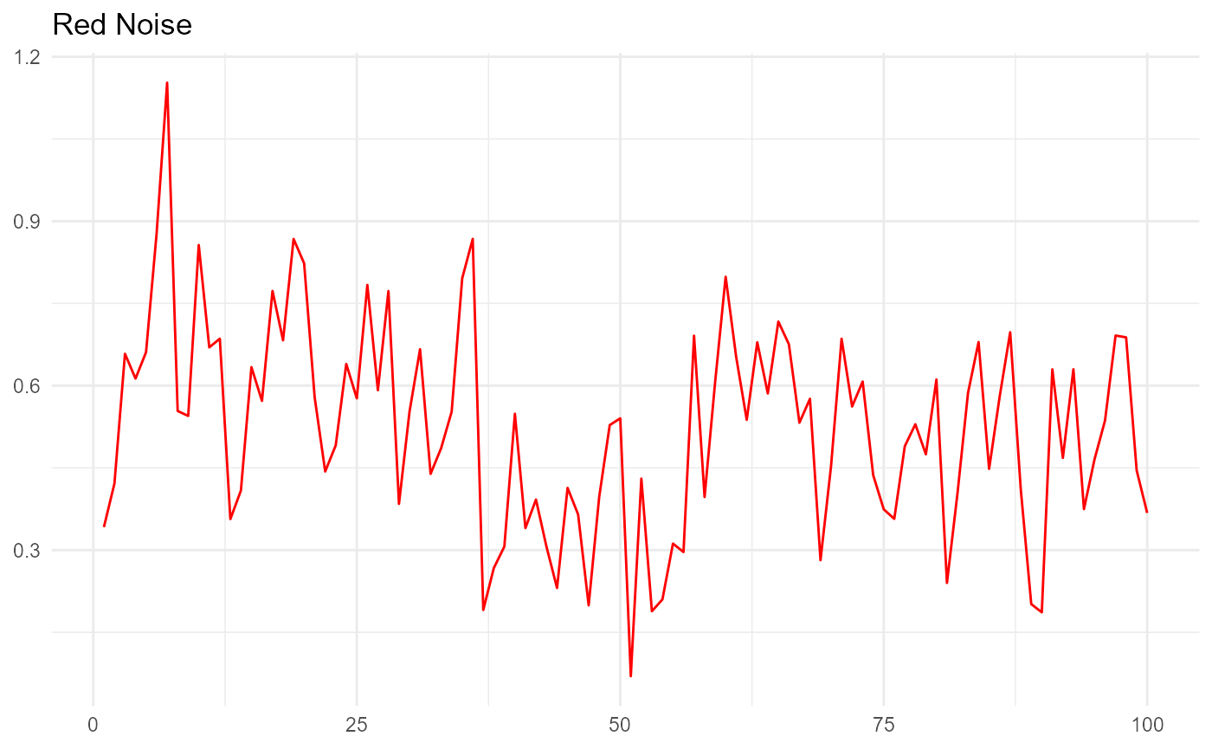
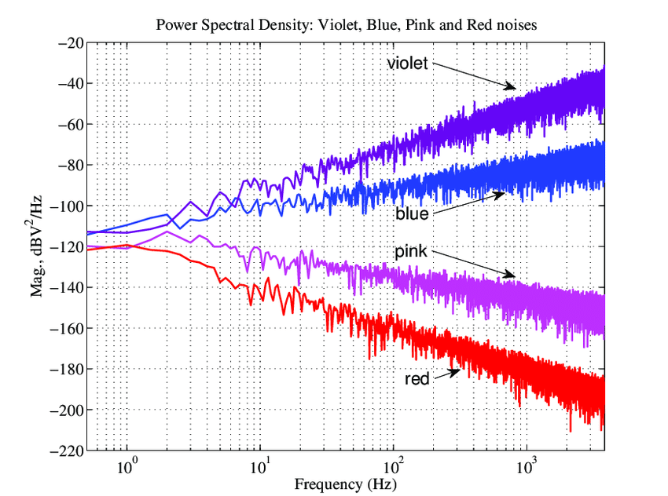
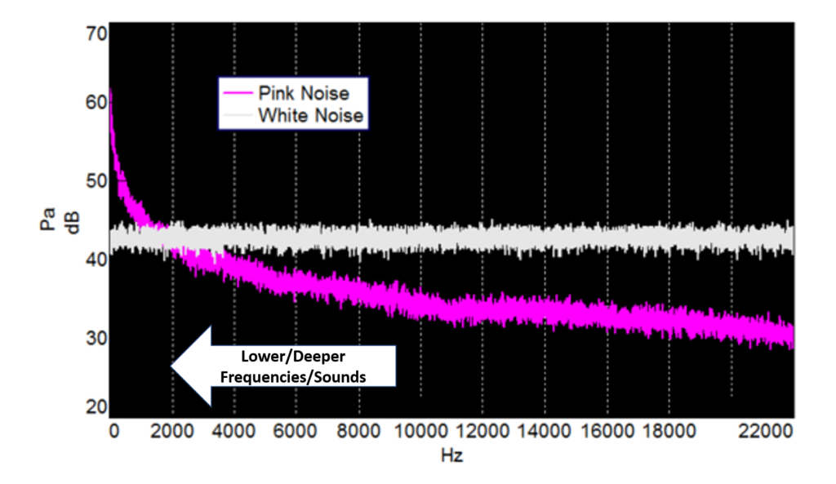
Colored noises
Pleas note:
in opposite to wgn we can introduce the noises that are differ from wgn as colored noises, for instance, it can be simulated as some random (stochastic) seasonality.

Slide 20
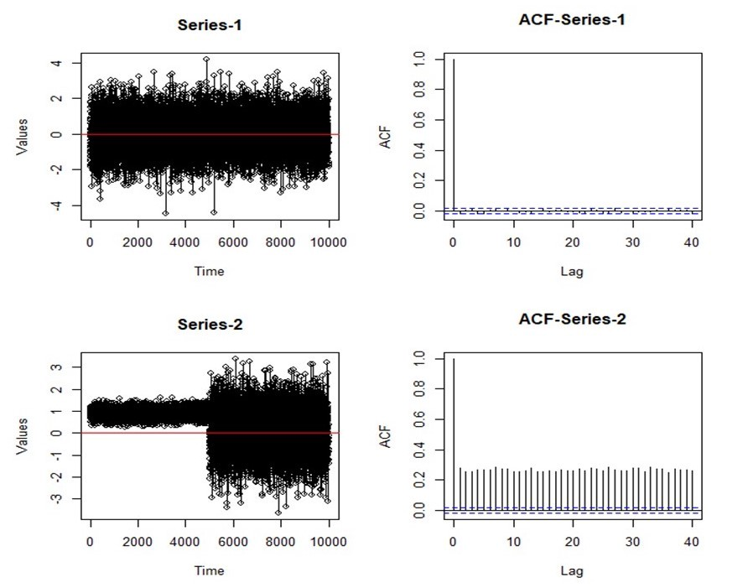
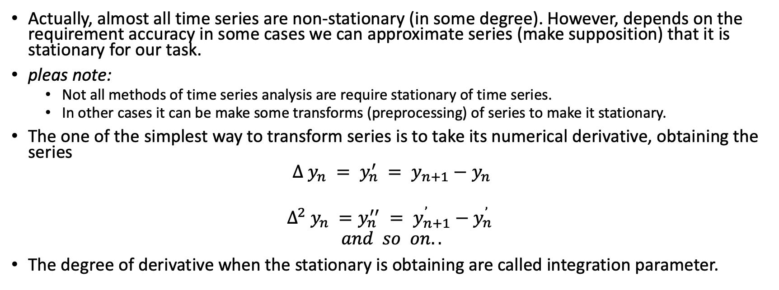
Transformation of non-stationary time series
Actually, almost all time series are non-stationary (in some degree). However, depends on the requirement accuracy in some cases we can approximate series (make supposition) that it is stationary for our task.
pleas note:
Not all methods of time series analysis are require stationary of time series.
In other cases it can be make some transforms (preprocessing) of series to make it stationary.
The one of the simplest way to transform series is to take its numerical derivative, obtaining the series
$$Δ y_{n} = y_{n}^{′} = y_{n+1}−y_{n}$$
$$Δ^{2} y_{n} =y_{n}^{′′} = y_{n+1}^{’}−y_{n}^{’}$$
$$and so on..$$
The degree of derivative when the stationary is obtaining are called integration parameter.

Slide 21
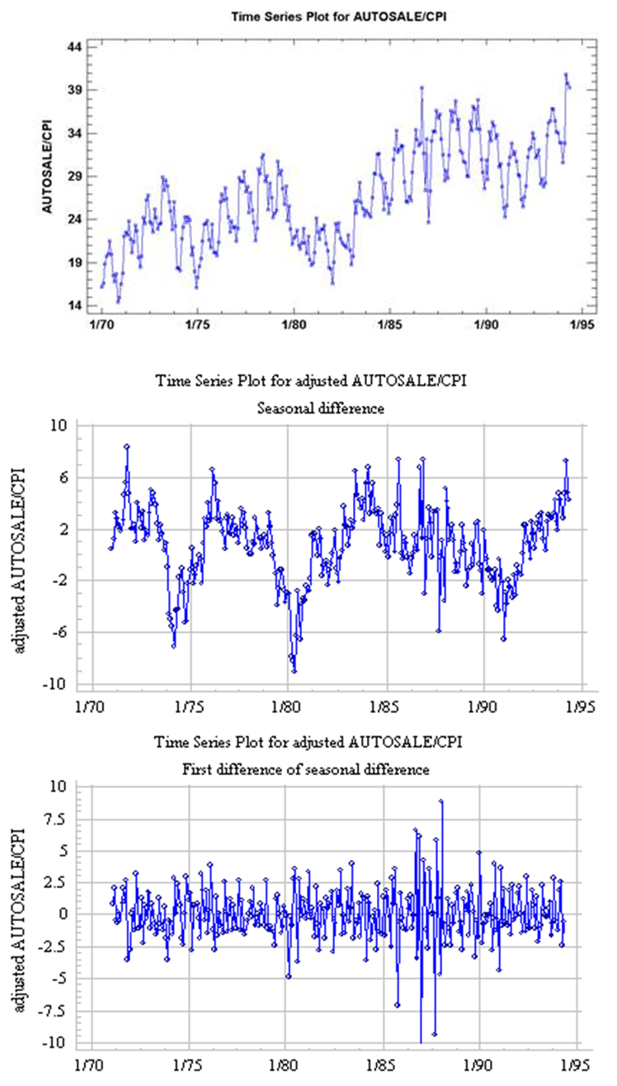
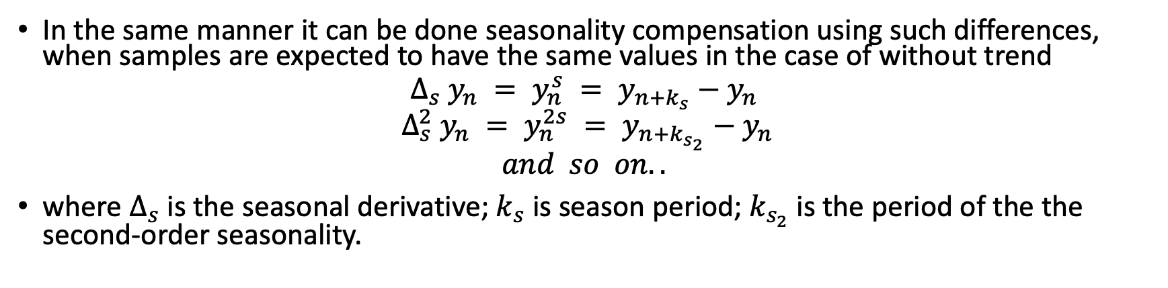
Transformation of non-stationary time series
In the same manner it can be done seasonality compensation using such differences, when samples are expected to have the same values in the case of without trend
$$Δ_{s} y_{n} = y_{n}^{s} = y_{n+k_{s}}−y_{n}$$
$$Δ_{s}^{2} y_{n} = y_{n}^{2s} = y_{n+k_{s_{2}}}−y_{n}$$
$$and so on..$$
where $Δ_{s}$ is the seasonal derivative; $k_{s}$ is season period; $k_{s_{2}}$ is the period of the the second-order seasonality.

Slide 22
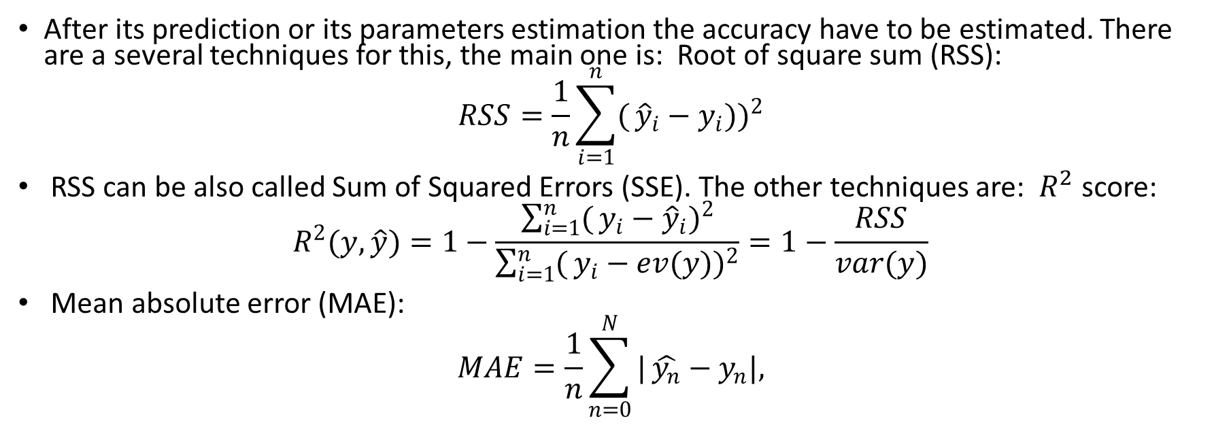
Accuracy measures
After its prediction or its parameters estimation the accuracy have to be estimated. There are a several techniques for this, the main one is: Root of square sum (RSS):
$$RSS=\frac{1}{n}\sum_{i=1}^{n}{(}{\hat{y}}_{i}−y_{i}))^{2}$$
RSS can be also called Sum of Squared Errors (SSE). The other techniques are: $R^{2}$ score:
$$R^{2}(y,\hat{y})=1−\frac{\sum_{i=1}^{n}{(}y_{i}−{\hat{y}}_{i})^{2}}{\sum_{i=1}^{n}{(}y_{i}−ev(y))^{2}}=1−\frac{RSS}{var(y)}$$
Mean absolute error (MAE):
$$MAE=\frac{1}{n}\sum_{n=0}^{N}{|}\hat{y_{n}}−y_{n}|,$$

Slide 23
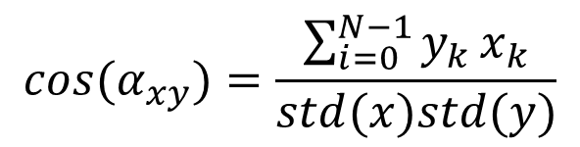
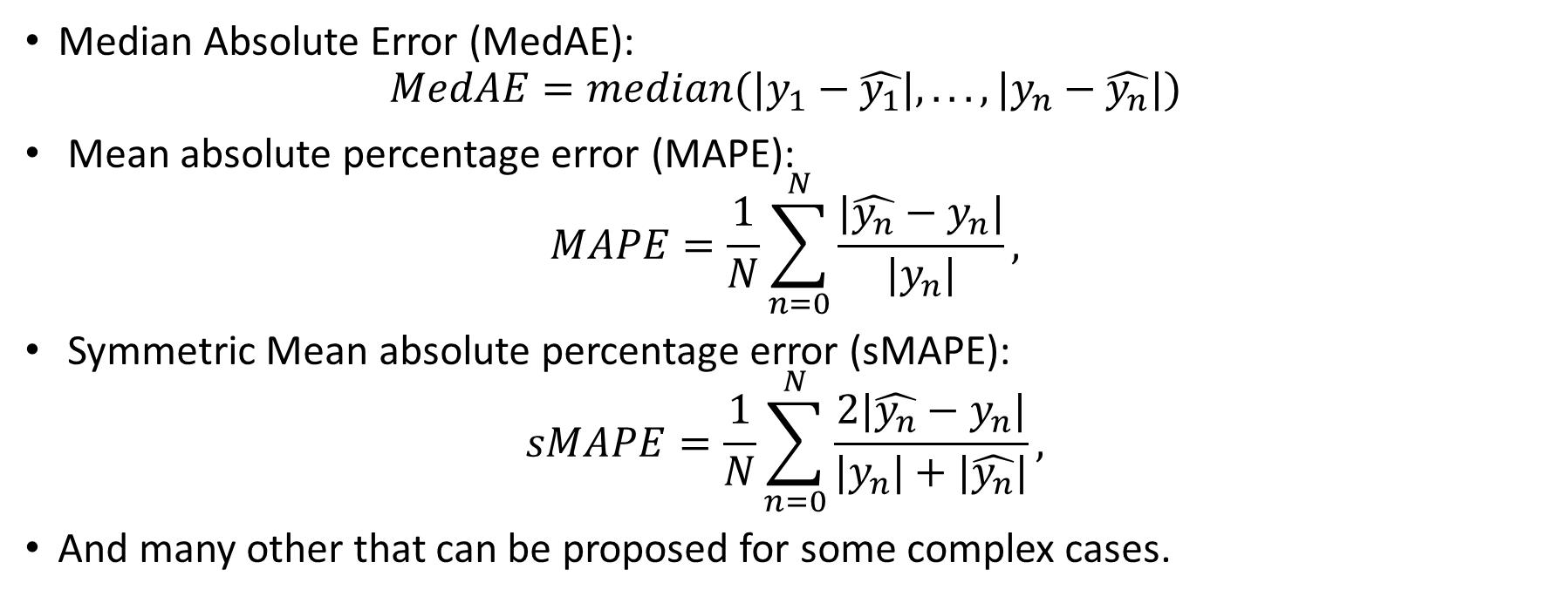
Accuracy measures
Median Absolute Error (MedAE):
$$MedAE=median(|y_{1}−\hat{y_{1}}|,...,|y_{n}−\hat{y_{n}}|)$$
Mean absolute percentage error (MAPE):
$$MAPE=\frac{1}{N}\sum_{n=0}^{N}{\frac{|\hat{y_{n}}−y_{n}|}{|y_{n}|}},$$
Symmetric Mean absolute percentage error (sMAPE):
$$sMAPE=\frac{1}{N}\sum_{n=0}^{N}{\frac{2|\hat{y_{n}}−y_{n}|}{|y_{n}|+|\hat{y_{n}}|}},$$
And many other that can be proposed for some complex cases.
$$cos(α_{xy})=\frac{\sum_{i=0}^{N−1}{y_{k}}x_{k}}{std(x)std(y)}$$

Slide 24
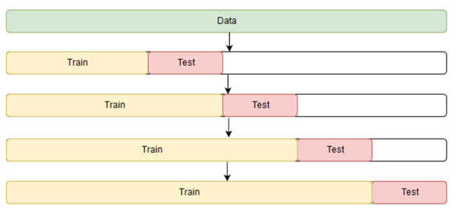
Cross-validation
It is have to be noted that the error value depends on the parameters (i.e. features) of a chosen algorithm.
These parameters as a rule can be optimized using some part of a series as testing (or validation samples) in opposite to other which is taken as training one. This routine is known as cross-validation.
In analogue to k-fold it can be introduced cross-validation on a rolling basis technique.

Slide 25
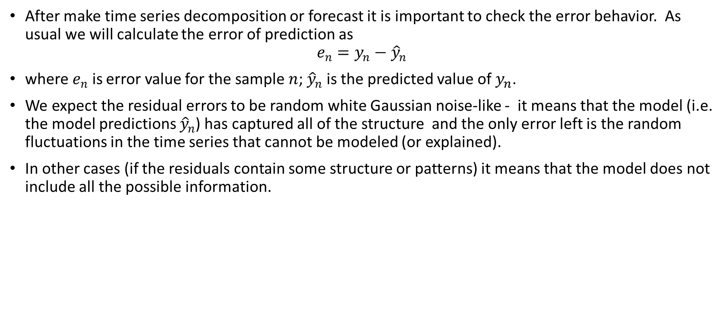
Residuals
After make time series decomposition or forecast it is important to check the error behavior. As usual we will calculate the error of prediction as
$$e_{n}=y_{n}−{\hat{y}}_{n}$$
where $e_{n}$ is error value for the sample $n$; ${\hat{y}}_{n}$ is the predicted value of $y_{n}$.
We expect the residual errors to be random white Gaussian noise-like - it means that the model (i.e. the model predictions ${\hat{y}}_{n}$) has captured all of the structure and the only error left is the random fluctuations in the time series that cannot be modeled (or explained).
In other cases (if the residuals contain some structure or patterns) it means that the model does not include all the possible information.

Slide 26
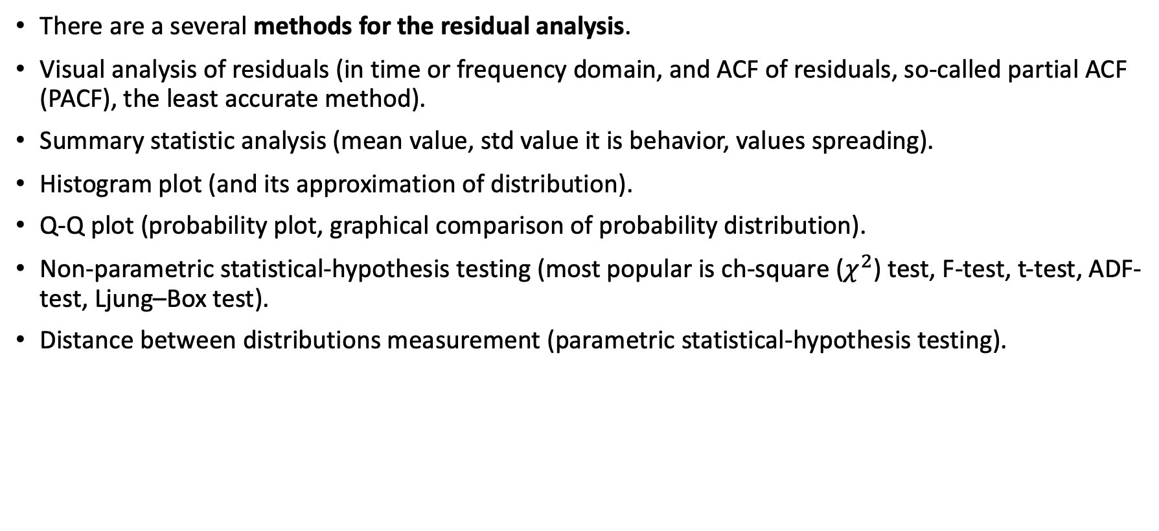
Residual analysis
There are a several methods for the residual analysis.
Visual analysis of residuals (in time or frequency domain, and ACF of residuals, so-called partial ACF (PACF), the least accurate method).
Summary statistic analysis (mean value, std value it is behavior, values spreading).
Histogram plot (and its approximation of distribution).
Q-Q plot (probability plot, graphical comparison of probability distribution).
Non-parametric statistical-hypothesis testing (most popular is ch-square ($χ^{2}$) test, F-test, t-test, ADF-test, Ljung–Box test).
Distance between distributions measurement (parametric statistical-hypothesis testing).

Slide 27
Classification of Methods of the Time Series Analysis. Model based
Linear regression
or regression task reduced to linear, for instance polynomial regression.
AutoRegression-Moving Average
ARMA and its variants, including ARIMA, SARIMAX, ARIFMA, AR, MA, VAR and e.t.c..
ANalysis Of VAriance (ANOVA) and its variants,
including F-Test, Multivariate ANOVA, and e.t.c.
Adaptive Filtration models,
including Winer filter, Kalman fliter, linear adaptive filters, moving average models and e.t.c.
Decomposition models,
including Prony decomposition, Principle component analysis (PCA), Matrix penciling, Dynamic mode decomposition (DMD), singular signal analysis (SSA) and e.t.c.
Time-frequency models
short-time Fourier transform, fractional Fourier transform and e.t.c.

Slide 28
Classification of Methods of the Time Series Analysis. Heuristics-based
Generalized AutoRegressive Conditional Heteroskedasticity
GARCH and its variants, including ARCH, and e.t.c.
Intrinsic mode decomposition models
empirical mode decomposition (EMD), variation mode decomposition (VMD), hilbert vibration transform (HVT), emperical wavelet transfrom (EWT) and e.t.c.).
Time-pseudo-frequency models
wavelet transform, e.t.c.

Slide 29
Classification of Methods of the Time Series Analysis. Machine learning models (Data-driven models)
Classical supervised methods
knn, trees, boosting, svm, and e.t.c..
Deep neural networks
recurrent networks, 1d-and 2d -convolution networks, and e.t.c. Non-linear AutoRegression models (NAR).
Non-linear unsupervised methods
autoencoders, gaussian-mixture models, nonlinear pca, t-sne, and e.t.c.

Slide 30
Classification of Methods of the Time Series Analysis. Note
in other classification we can classify some of the methods above into harmonic analysis class:
Decomposition models, including
Prony decomposition,
Principle component analysis (PCA),
Matrix penciling,
Dynamic mode decomposition (DMD),
singular signal analysis (SSA) and e.t.c.
Time-frequency models
short-time Fourier transform, fractional Fourier transform and e.t.c.
Intrinsic mode decomposition models
empirical mode decomposition (EMD),
variation mode decomposition (VMD),
Hilbert vibration transform (HVT),
empirical wavelet transform (EWT) and e.t.c.).
Time-pseudo-frequency models (wavelet transform, e.t.c.).

